Slide 1
Event-Driven Programming

Slide 2
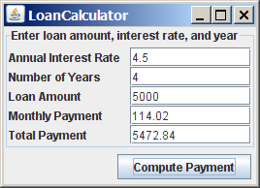
Motivations
Suppose you wish to write a GUI program that lets the user enter the loan amount, annual interest rate, and number of years, and click the Compute Loan button to obtain the monthly payment and total payment. How do you accomplish the task? You have to use event-driven programming to write the code to respond to the button-clicking event.
LoanCalculator
Run

Slide 3
Procedural vs. Event-Driven Programming
Procedural programming is executed in procedural order.
In event-driven programming, code is executed upon activation of events.

Slide 4
Events
An event can be defined as a type of signal to the program that something has happened.
The event is generated by external user actions such as mouse movements, mouse clicks, and keystrokes, or by the operating system, such as a timer.

Slide 5
Event Classes

Slide 6
Event Information
An event object contains whatever properties are pertinent to the event. You can identify the source object of the event using the getSource() instance method in the EventObject class. The subclasses of EventObject deal with special types of events, such as button actions, window events, component events, mouse movements, and keystrokes. Table 15.1 lists external user actions, source objects, and event types generated.

Slide 7
Selected User Actions
Source Event Type User Action Object Generated
Click a button JButton ActionEvent
Click a check box JCheckBox ItemEvent, ActionEvent
Click a radio button JRadioButton ItemEvent, ActionEvent
Press return on a text field JTextField ActionEvent
Select a new item JComboBox ItemEvent, ActionEvent
Window opened, closed, etc. Window WindowEvent
Mouse pressed, released, etc. Component MouseEvent
Key released, pressed, etc. Component KeyEvent

Slide 8
The Delegation Model

Slide 9
The Delegation Model: Example
JButton jbt = new JButton("OK");
ActionListener listener = new OKListener();
jbt.addActionListener(listener);

Slide 10
Selected Event Handlers
Event Class Listener Interface Listener Methods (Handlers) ActionEvent ActionListener actionPerformed(ActionEvent)
ItemEvent ItemListener itemStateChanged(ItemEvent)
WindowEvent WindowListener windowClosing(WindowEvent)
windowOpened(WindowEvent)
windowIconified(WindowEvent)
windowDeiconified(WindowEvent)
windowClosed(WindowEvent)
windowActivated(WindowEvent)
windowDeactivated(WindowEvent)
ContainerEvent ContainerListener componentAdded(ContainerEvent)
componentRemoved(ContainerEvent) MouseEvent MouseListener mousePressed(MouseEvent)
mouseReleased(MouseEvent)
mouseClicked(MouseEvent)
mouseExited(MouseEvent)
mouseEntered(MouseEvent)
KeyEvent KeyListener keyPressed(KeyEvent)
keyReleased(KeyEvent)
keyTypeed(KeyEvent)

Slide 11
MouseEvent

Slide 12
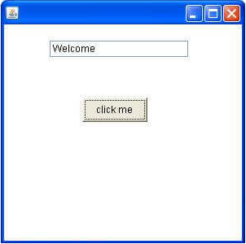
Java Event Handling Example
Courtesy: https://www.javatpoint.com/event-handling-in-java
Three ways to implement
Within class
Using another class
Using anonymous class

Slide 13
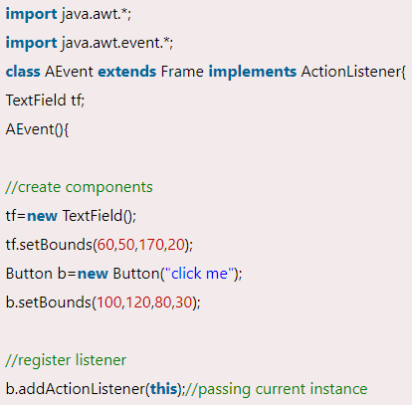
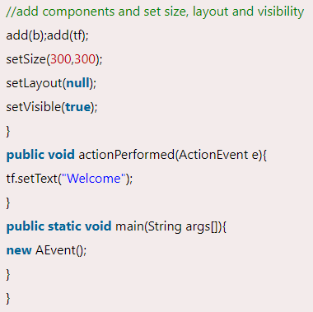
Within Class

Slide 14
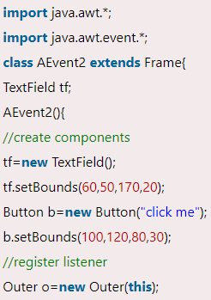
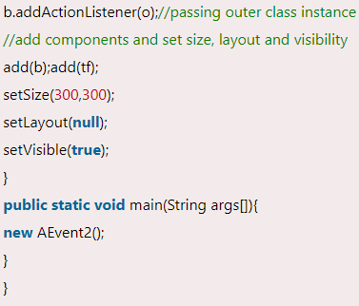
Using outer class

Slide 15
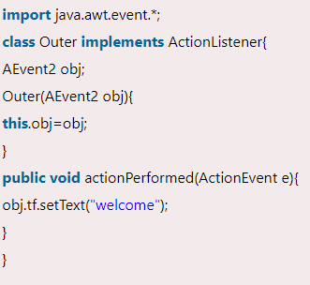
Using outer class (contd.)

Slide 16
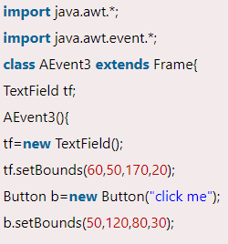
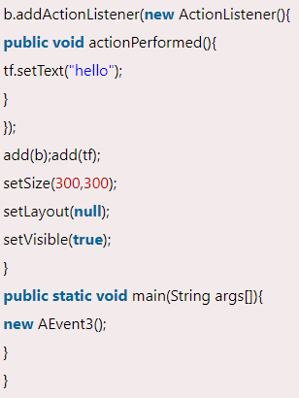
Using anonymous class

Slide 17
Handling Mouse Events
Java provides two listener interfaces, MouseListener and MouseMotionListener, to handle mouse events.
The MouseListener listens for actions such as when the mouse is pressed, released, entered, exited, or clicked.
The MouseMotionListener listens for actions such as dragging or moving the mouse.

Slide 18
Handling Mouse Events

Slide 19
Handling Keyboard Events
To process a keyboard event, use the following handlers in the KeyListener interface:
keyPressed(KeyEvent e)
Called when a key is pressed.
keyReleased(KeyEvent e)
Called when a key is released.
keyTyped(KeyEvent e)
Called when a key is pressed and then released.

Slide 20
The KeyEvent Class
Methods:
getKeyChar() method
getKeyCode() method
Keys:
Home VK_HOME
End VK_END
Page Up VK_PGUP
Page Down VK_PGDN
etc...

Slide 21
The KeyEvent Class, cont.

